Slide 1
Project Presentation
By
Rhythin Renny

Slide 2
Objective
Create prediction models for 4 datasets pas per requirements
2 classification models
2 regression models
Explain the steps taken and challenges faced

Slide 3
Problem-1 Diamond Price
Create model for diamond price dataset
Required min accuracy is 85%
Predict price column based on other features

Slide 4
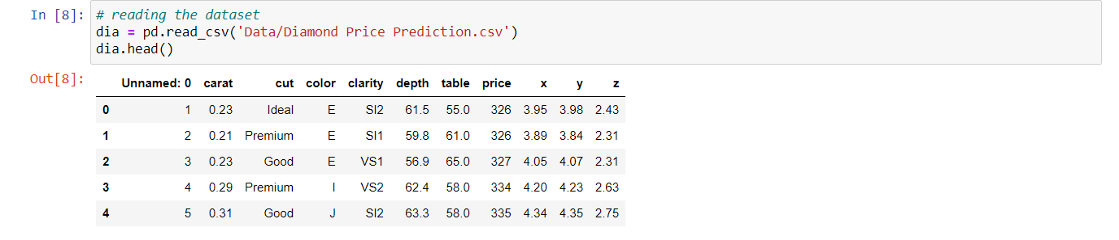
Reading Dataset

Slide 5
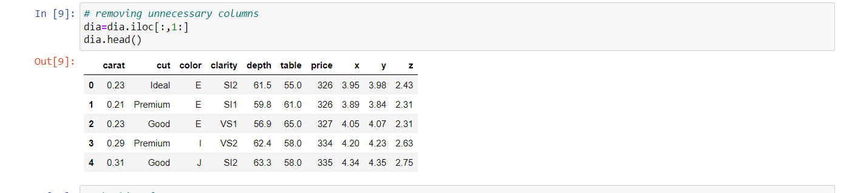
Removing unnecessary columns

Slide 6
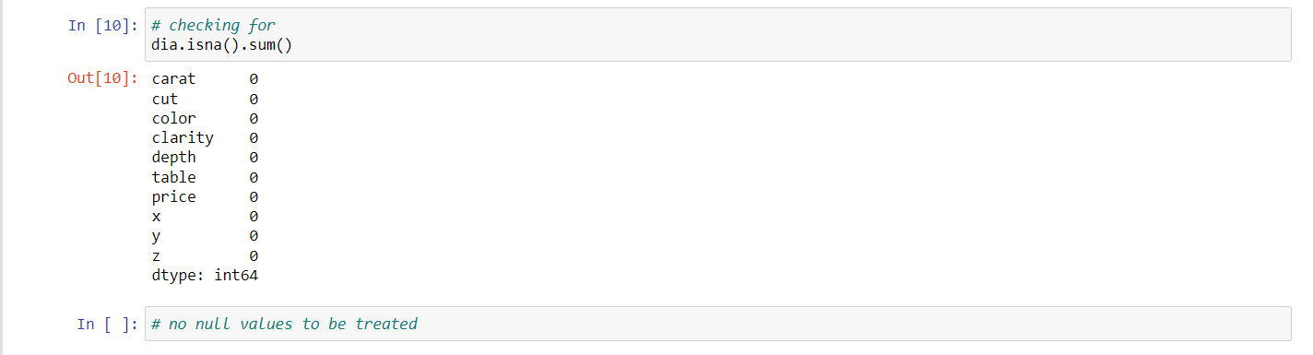
Checking for Missing values

Slide 7
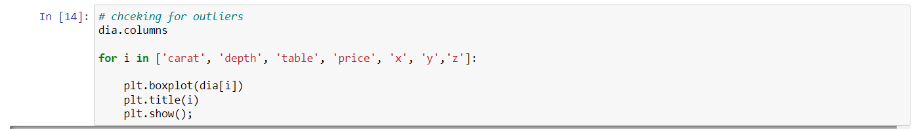
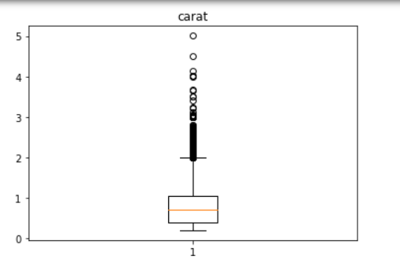
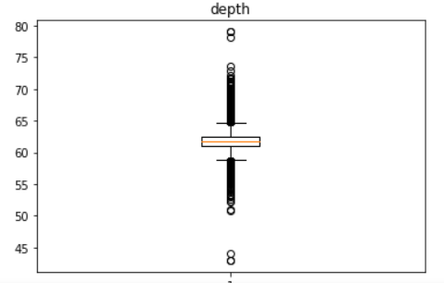
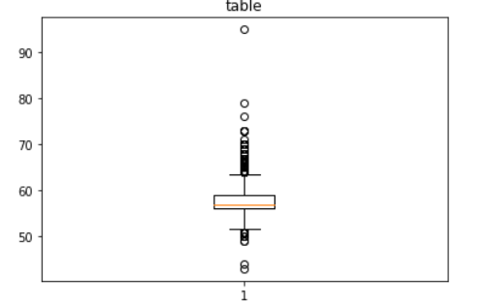
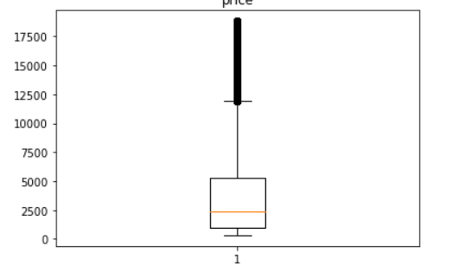
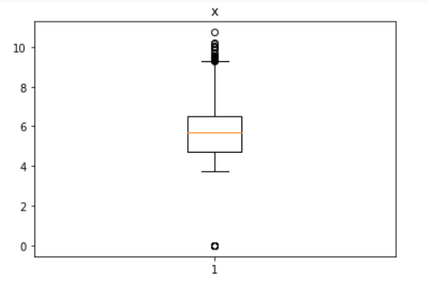
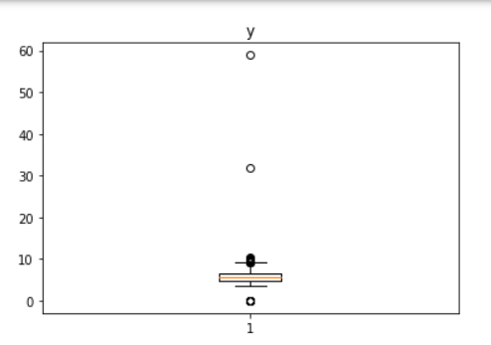
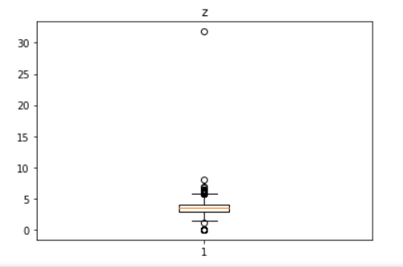
Checking for outliers

Slide 8
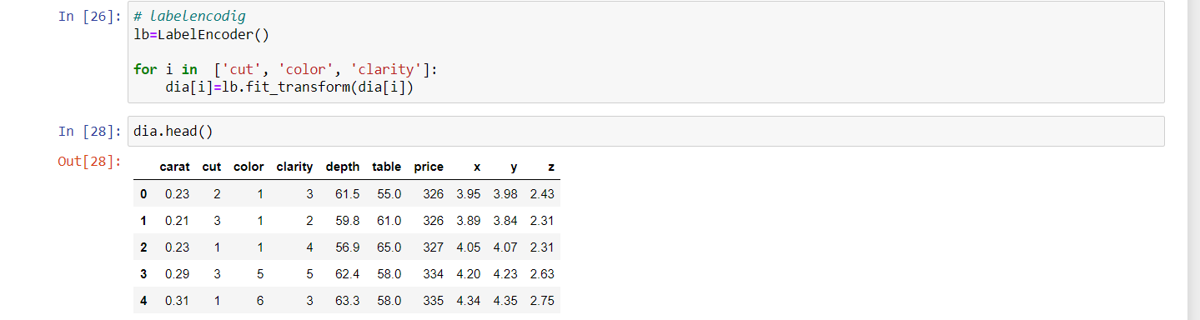
Label encoding categorical data

Slide 9
Dependent –Independent variable split

Slide 10
Standardization of data

Slide 11
Train-Test split

Slide 12
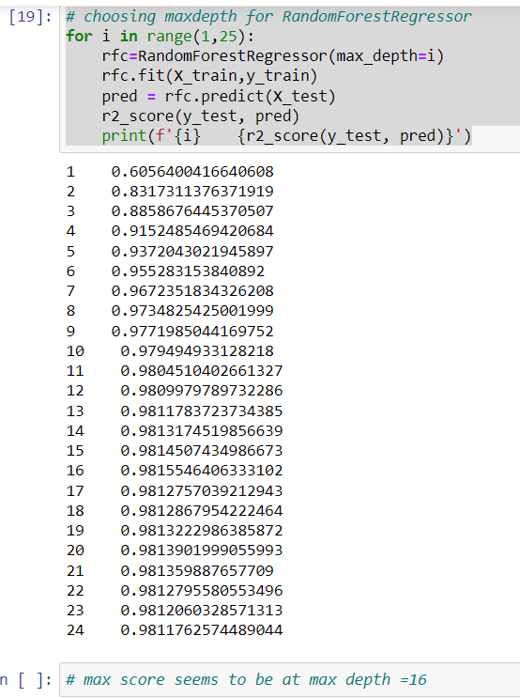
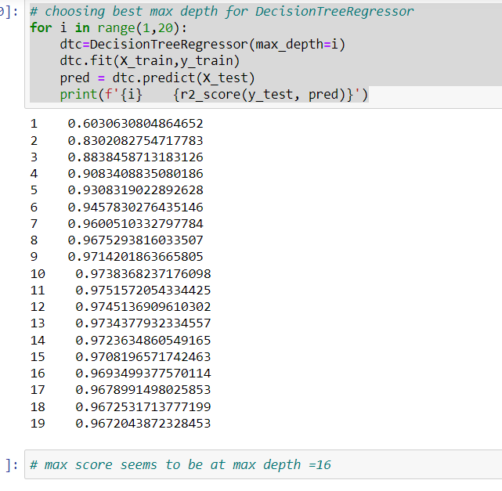
Training model and comparing accuracy

Slide 13
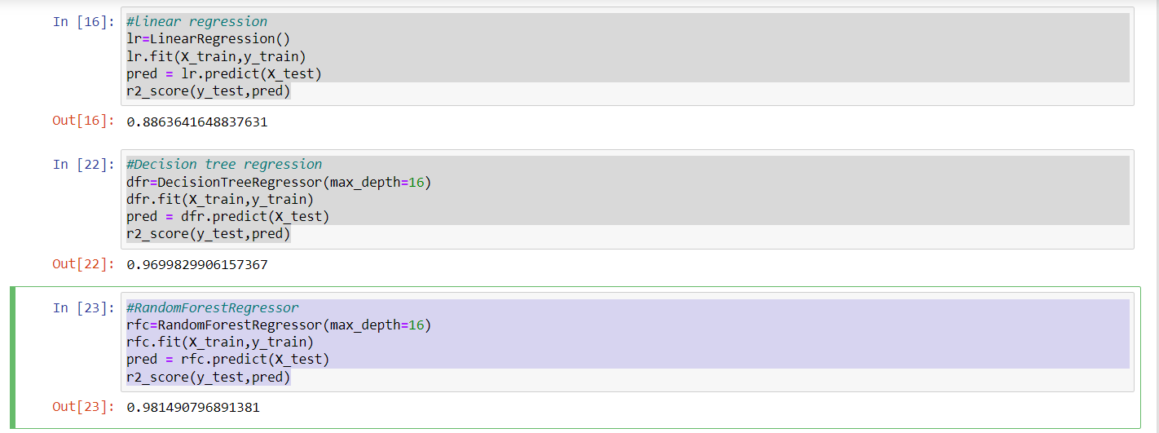
Training model and comparing accuracy

Slide 14
Conclusion
choosing the random forest regression method for this problem as this gives the best accuracy ~98%
the accuracy achived is higher than the required accuracy of 85%
successfully created a model based on requirements for Dimond price dataset

Slide 15
Problem-2 House Price Dataset
Create model for House price dataset
Required min accuracy is 85%
Predict price column based on other features

Slide 16
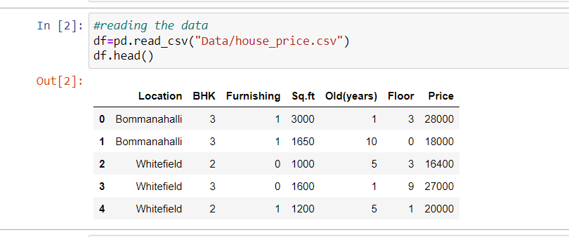
Reading the dataset

Slide 17
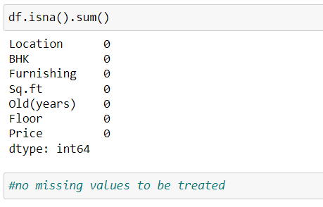
Checking for missing values

Slide 18
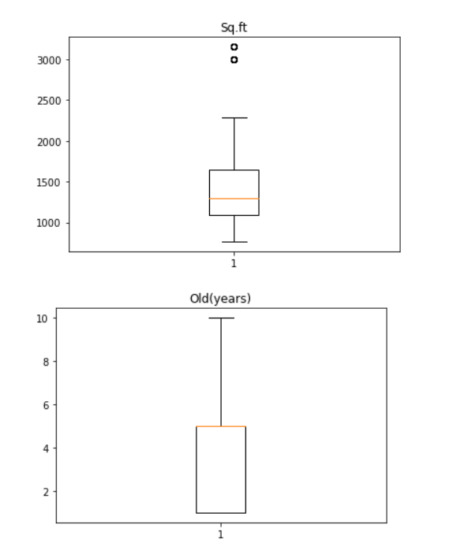
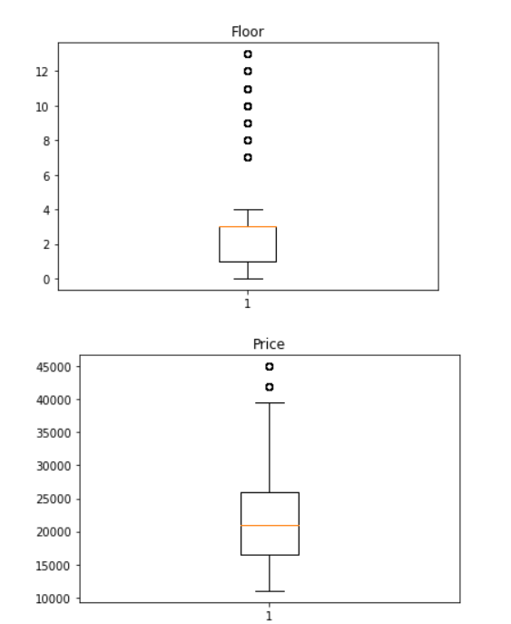
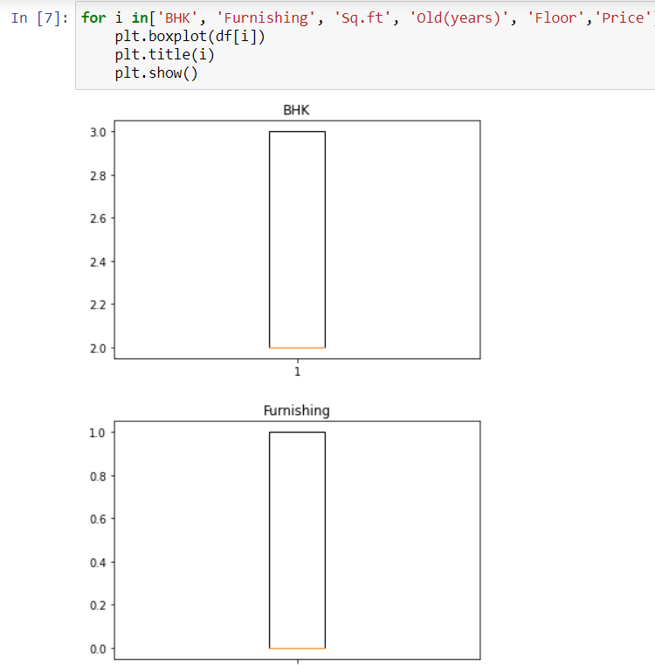
Checking for outliers with help of boxplot

Slide 19
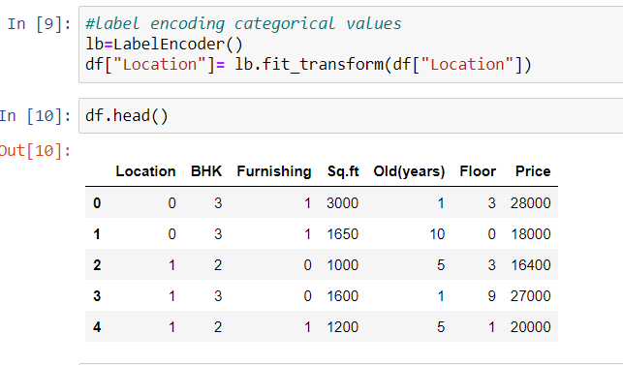
Label encoding

Slide 20
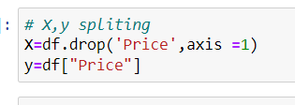
Dependent Independent variable Split

Slide 21
Train-Test Split

Slide 22
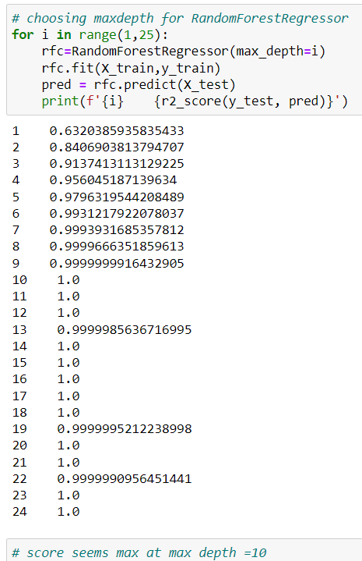
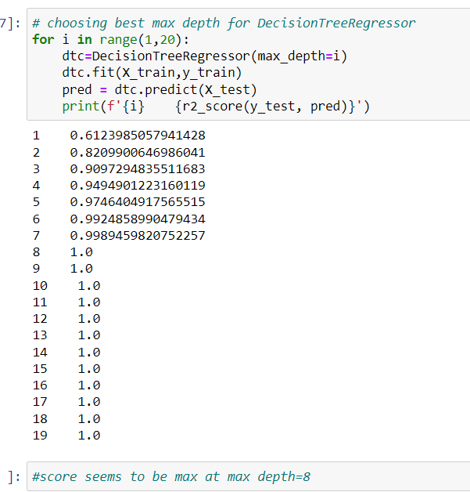
Training and comparing models

Slide 23
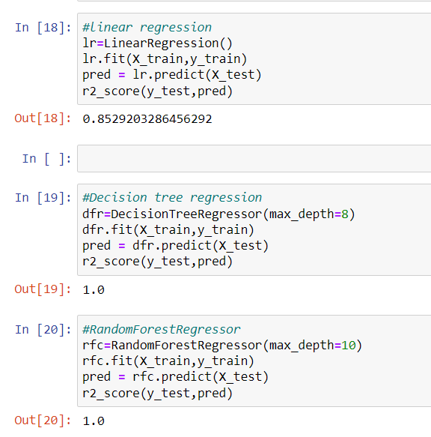
Training model

Slide 24
Conclusion
maximum score is 100% in bot random forest regressor and decesion tree regressor
the accuracy we got is above the required accuracy of 85%
successfully created a model as per requirements

Slide 25
Problem-3 Company Attrition Dataset
Create model for company attrition dataset
Required min accuracy is 85%
Predict the left column based on other features

Slide 26
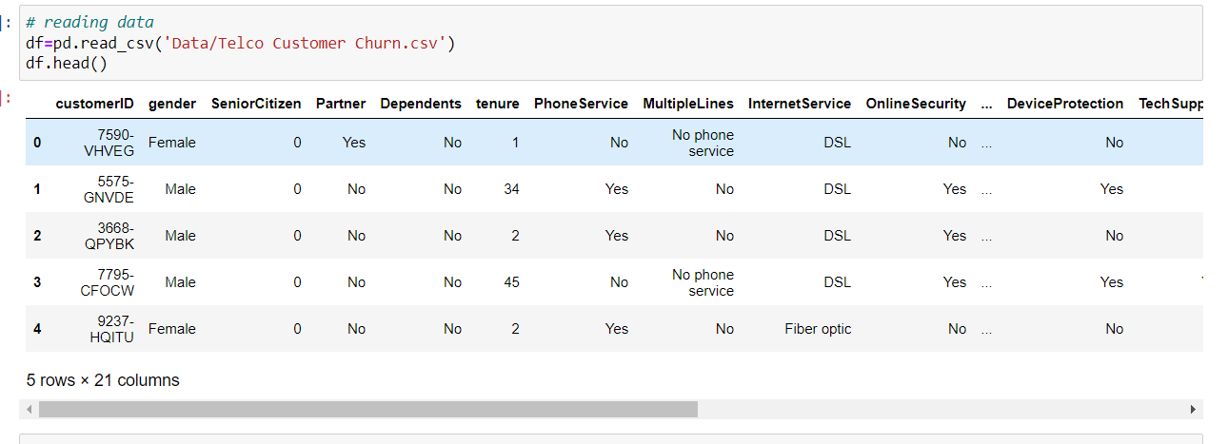
Reading the dataset

Slide 27
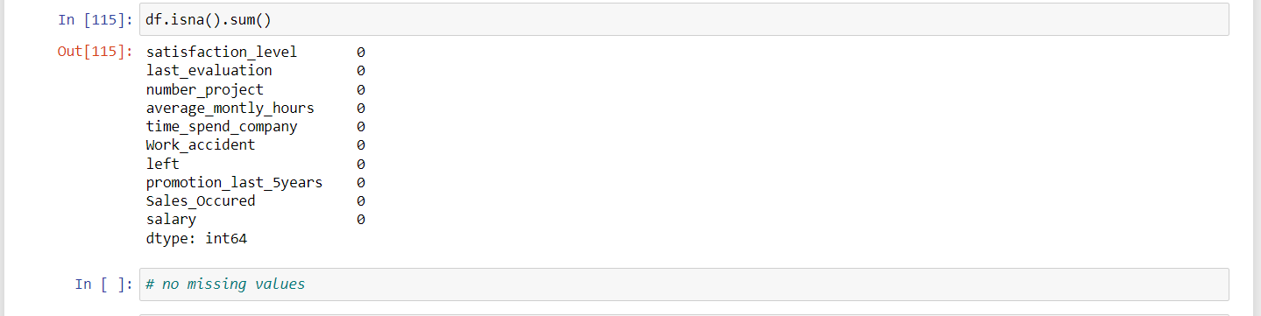
Checking for missing values

Slide 28
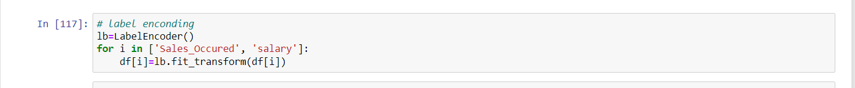
Label encoding categorical data

Slide 29
Dependent-Independent variable split

Slide 30
Train-Test Split

Slide 31
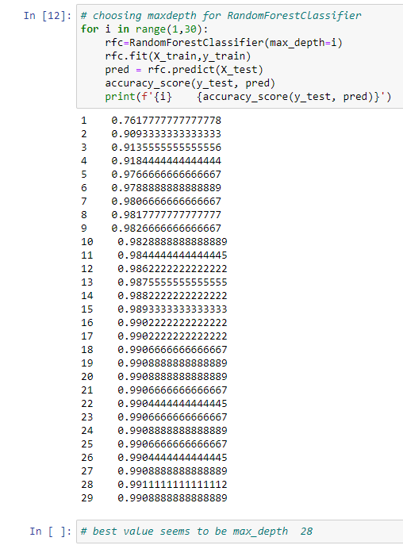
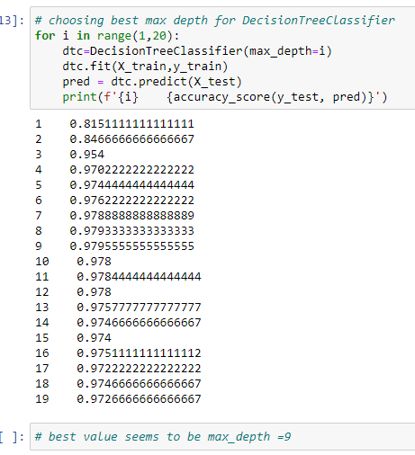
Train models and compare accuracies

Slide 32
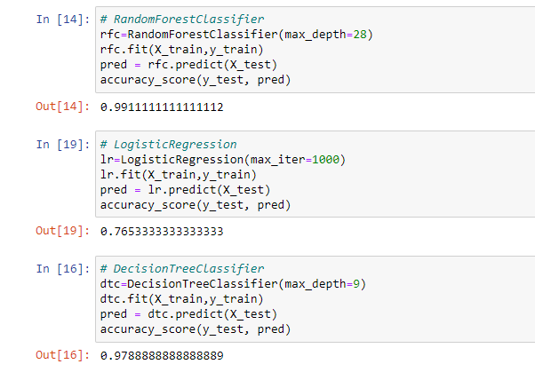
Train models and compare accuracies

Slide 33
Conclusion
The best results we got was from random forest classifier with accuracy 99.1%
The acquired accuracy is greater than the required accuracy 85%
Successfully created a model for the dataset based on requirements

Slide 34
Problem-4 Fraud dataset
Create model for fraud dataset
Required min accuracy is 85%
Predict fraud risk based on other features

Slide 35
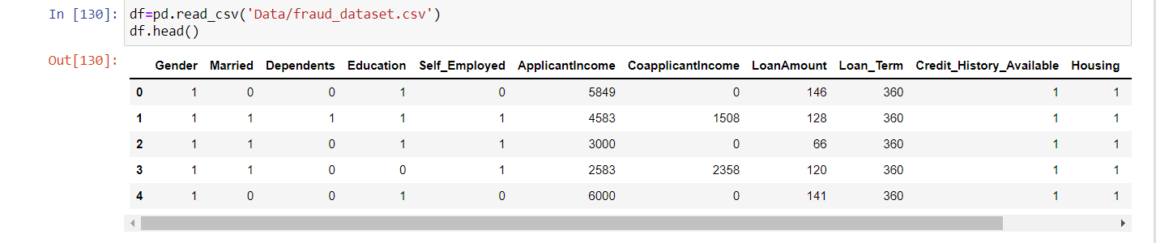
Reading data

Slide 36
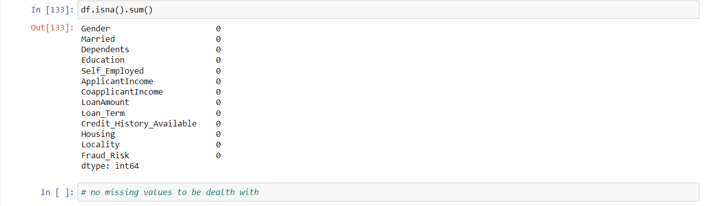
Checking for missing values

Slide 37
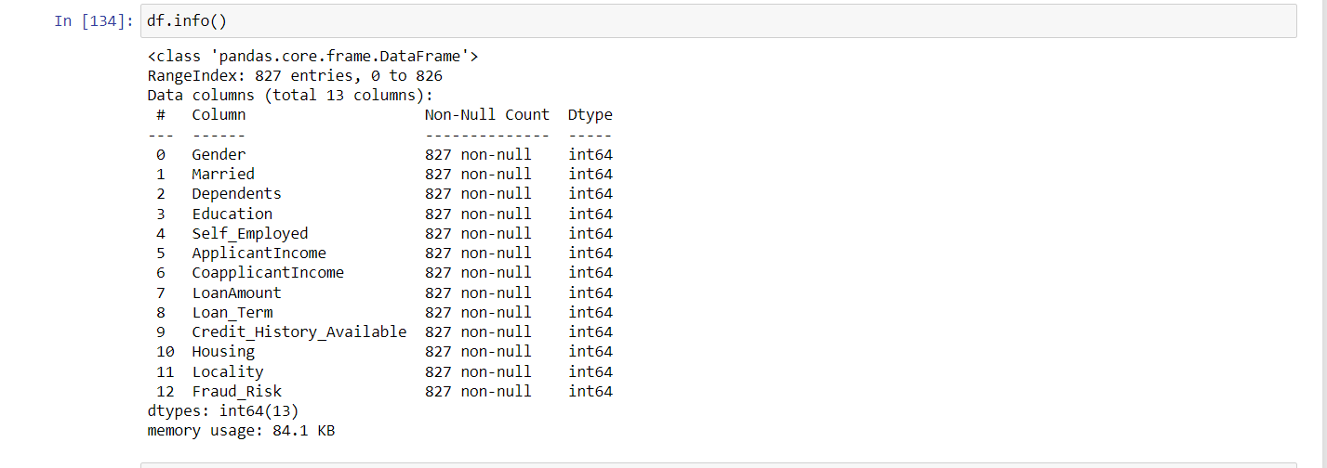
Checking data types

Slide 38
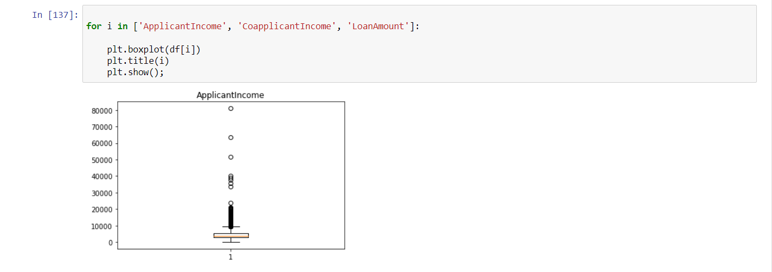
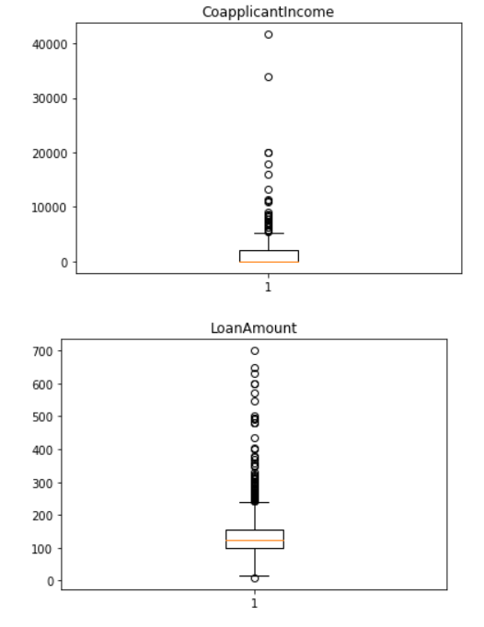
Checking For Outliers

Slide 39
Dependent-Independent Variable Split

Slide 40
Train-Test Split

Slide 41
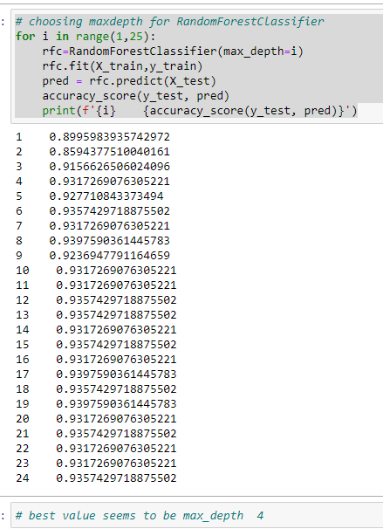
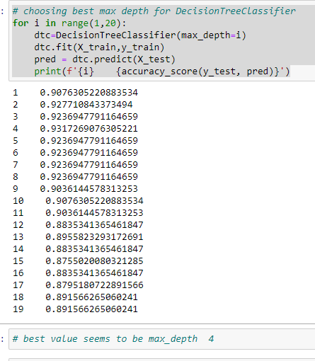
Training model and comparing accuracies

Slide 42
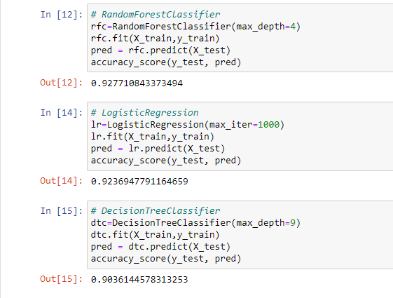
Training model and comparing accuracies

Slide 43
Conclusion
The best results are from random forest classifier with accuracy 92.8%
The acquired accuracy is greater than the required accuracy 85%
Successfully created a model as per requirements

Slide 44
Summary
Created 4 models for 4 different problems
2 regression models and 2 classification models
Successfully created the models for all 4 datasets as per requirements

Slide 45
Thank You

